Slide 1
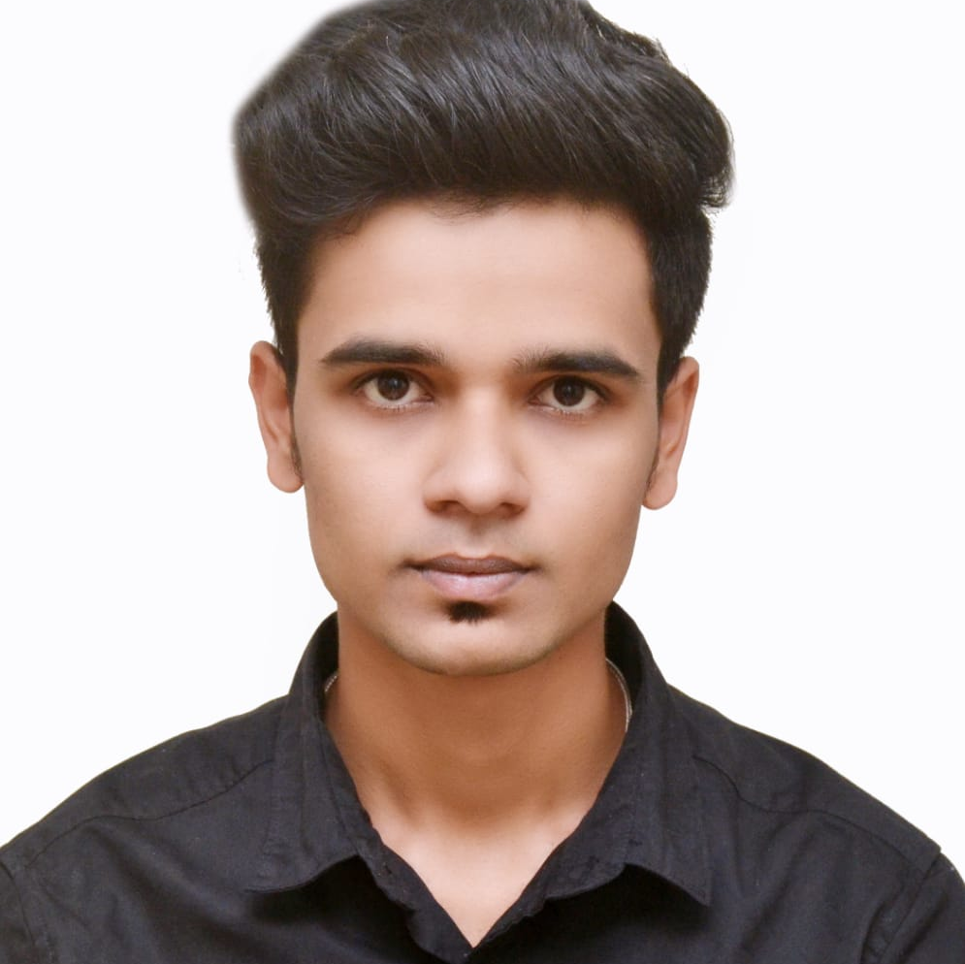



Shrinivas A Mani
Analyst/Software Engineer
Bachelor Of Civil Engineering:
2018 - 2021
Skills
PowerApps
SharePoint
Power Automate
Power BI Desktop
Core Java
AddOns
Github
Visual Studio Code
Additional Details
Communication Skills
Team management
Mumbai
Shrinivas.arun-mani@capgemini.com
+91 8329303615
A4
Software Engineer who is Strong in design and integration with intuitive problem-solving skills. Passionate about implementing and launching new projects.
Hands on experience on development applications of PowerApps using SharePoint & Power Automate.
1. Leave Management System (LMS) Application
Developed the leave management system application on PowerApps using SharePoint list and created a flow between SharePoint, PowerApps and Gmail using Power Automate.
2. Completed Git, GitHub at Capgemini Degreed Platform
Learnt the concepts of Git and GitHub, simultaneously applied the concepts for better learning.
POWERAPPS DEVELOPER
Coursera Certifications On:
1. Power BI Desktop.

